Slide 1


SIMATS ENGINEERING
SAVEETHA INSTITUTE OF MEDICAL AND TECHNICAL SCIENCES
MLA0301 - REINFORCEMENT LEARNING
Deep Q-Networks for Intelligent Decision-Making
Presented by: ​
S. Sirivally (192472371)​
Guided by: ​
Dr. Senthil G A​

Slide 2













Deep Q-Networks for Intelligent Decision-Making
■
Q-Learning Overview: Stores state-action values in a discrete Q-table.
Q-Table: Suited for small, discrete state spaces.
DQN: Scalable to massive/continuous state spaces.
■
Tabular Limitations: Large or continuous state spaces make traditional Q-tables computationally impractical.
■
Neural Function Approximation: DQN substitutes the Q-table with a Deep Neural Network to approximate Q-values.
→
→
→
→
■
State-to-Action Mapping: The network maps high-dimensional input states directly to Q-values for all available actions.

Slide 3
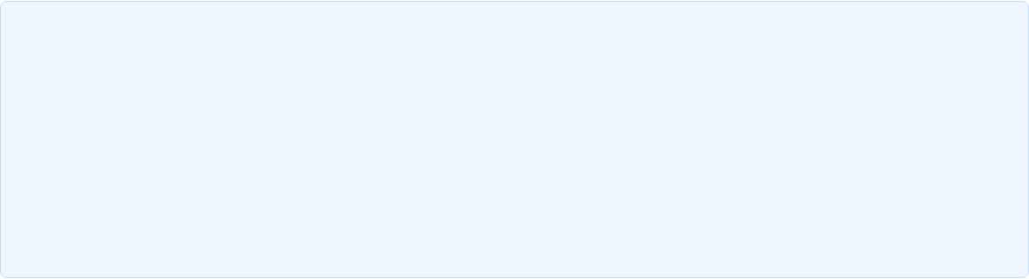

















DQN Architecture
HIDDEN LAYERS
INPUT
OUTPUT
→
→
→
■
Input Layer: Accepts state vector representation directly from environment sensors.
■
Output Layer: Predicts scalar Q-value estimate Q(s, a) for every available action.
■
Hidden Layers: Deep dense or convolutional layers extract high-level feature representations.
■
Action Selection: Agent selects action with maximum estimated Q-value (argmax Q).

Slide 4
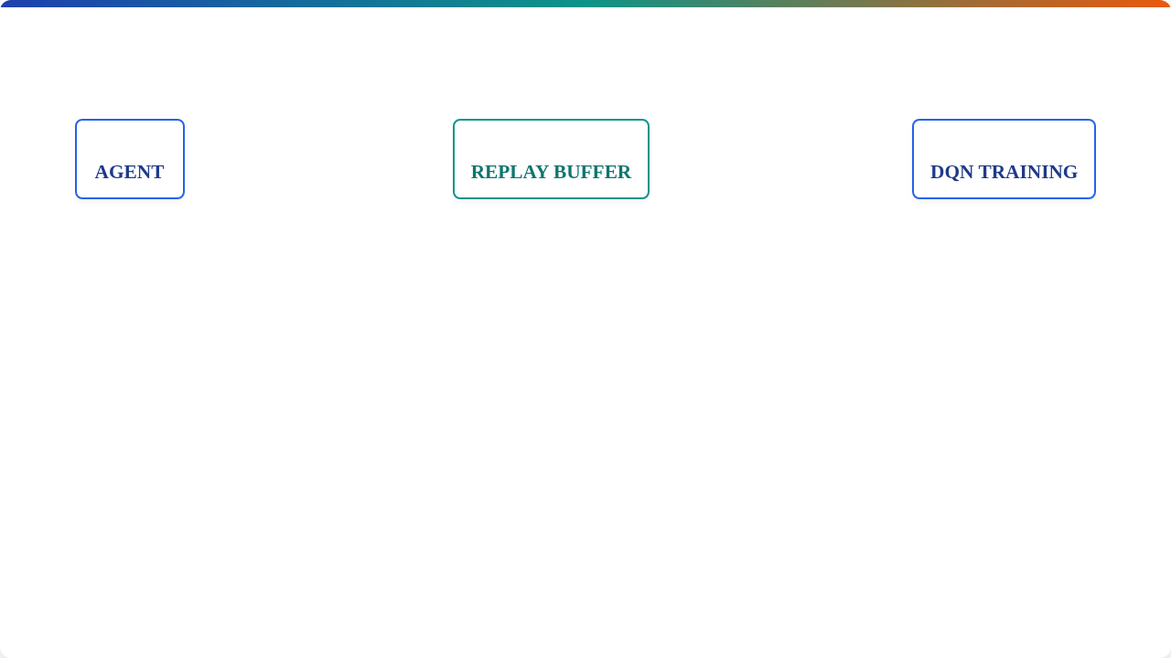


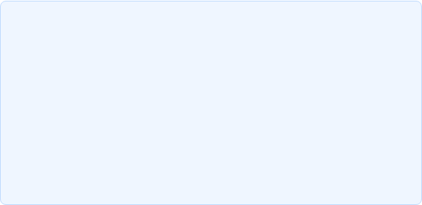



Experience Replay Buffer
→
→
→
→
■
Transitions e_t = (s_t, a_t, r_t, s_{t+1}) are stored in a cyclic memory buffer.
■
Decorrelates Samples: Sampling random mini-batches breaks temporal correlations between consecutive steps.
■
Prevents immediate deletion of valuable past state-action-reward experiences.
■
Sample Efficiency: Allows individual experience transitions to be reused in multiple gradient updates.

Slide 5









Target Network Stabilization
Dual Network Architecture
↓
Online Network (θ): Updated continuously at every training step via gradient descent.
Target Network (θ⁻): Kept frozen and updated periodically (every C steps) to copy online weights.
↓
■
Fixes target values to prevent non-stationary policy convergence oscillations.
■
Eliminates harmful feedback loops between action-value prediction and target evaluation.
↓

Slide 6









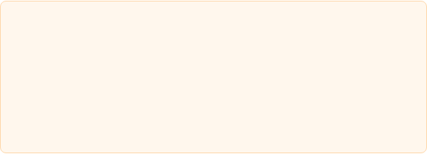

Classic Example: CartPole & Robotics
■
State Space (4D Vector):
→
→
■
Cart Position & Cart Velocity
■
Pole Angle & Pole Angular Velocity
■
Actions: Apply Force Left (-1) or Right (+1).
■
Reward: +1 for every timestep pole remains balanced.
■
Objective: Keep pole upright indefinitely.
• Autonomous Mobile Robots: Warehouse navigation and trajectory planning.
• Industrial Control: HVAC, manufacturing, and dynamic process tuning.

Slide 7
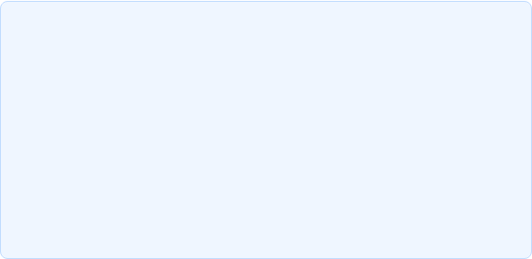



Deep Q-Networks: Key Takeaways
■
Function Approximation: Combines Q-Learning with Deep Neural Networks to solve large state spaces.
■
Stable Convergence: Target Networks remove moving target instabilities during gradient updates.
■
Scalability: Overcomes state-explosion limits inherent in classic tabular Q-learning.
■
Sample Efficiency: Experience Replay breaks sample correlation and reuses past transitions.

